Slide 1
Applied
Protocol Thinking
Duration
90 min
Summer of Protocols
Protocol Symposium
September 2025

Slide 2
Contents
Agenda
Intro
Literacies
Lenses
Worlds
Summer of Protocols
Protocol Symposium
September 2025

Slide 3

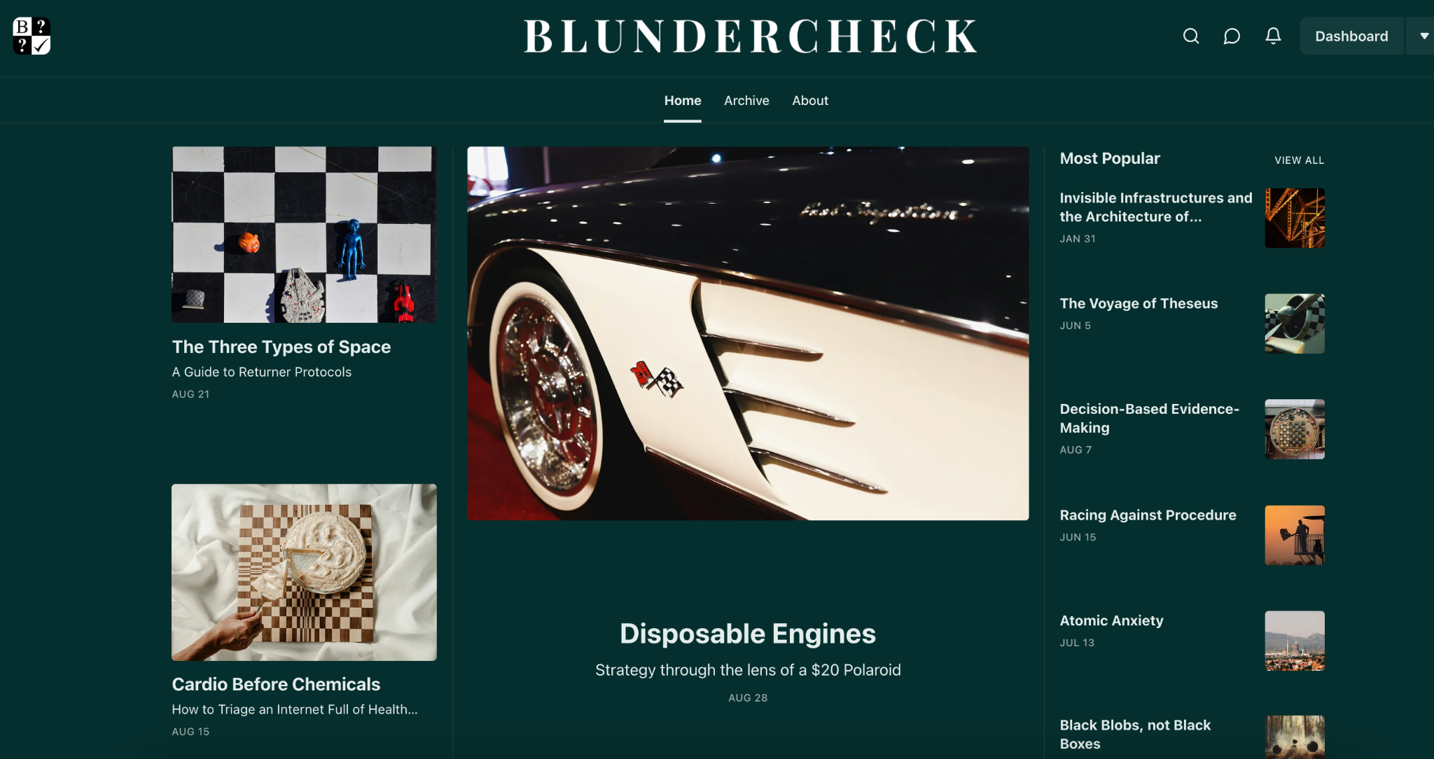

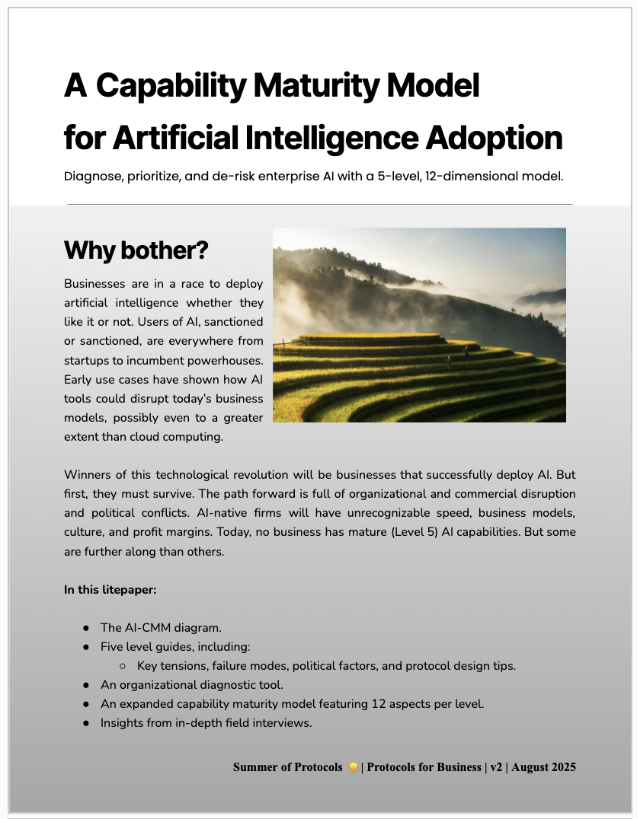

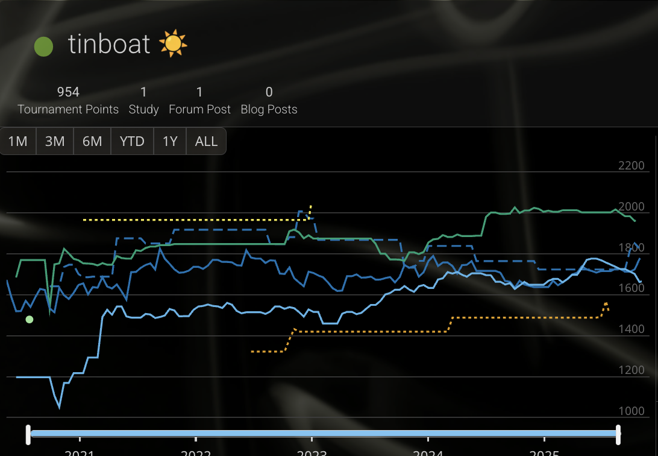
Hello everybody!
Me
Timber Stinson-Schroff
Project dev, blogs @ Blundercheck
Wrote Safe New World in 2023
Have run 30+ workshops on protocols
Previously: ghost writer at [redacted], safety and strategy at Yukon Gov’t, tech & tax policy at Gov’t of B.C., and market research at 1QBit.
Pretty good at chess
linktr.ee/timberss
Summer of Protocols
Protocol Symposium
September 2025

Slide 4
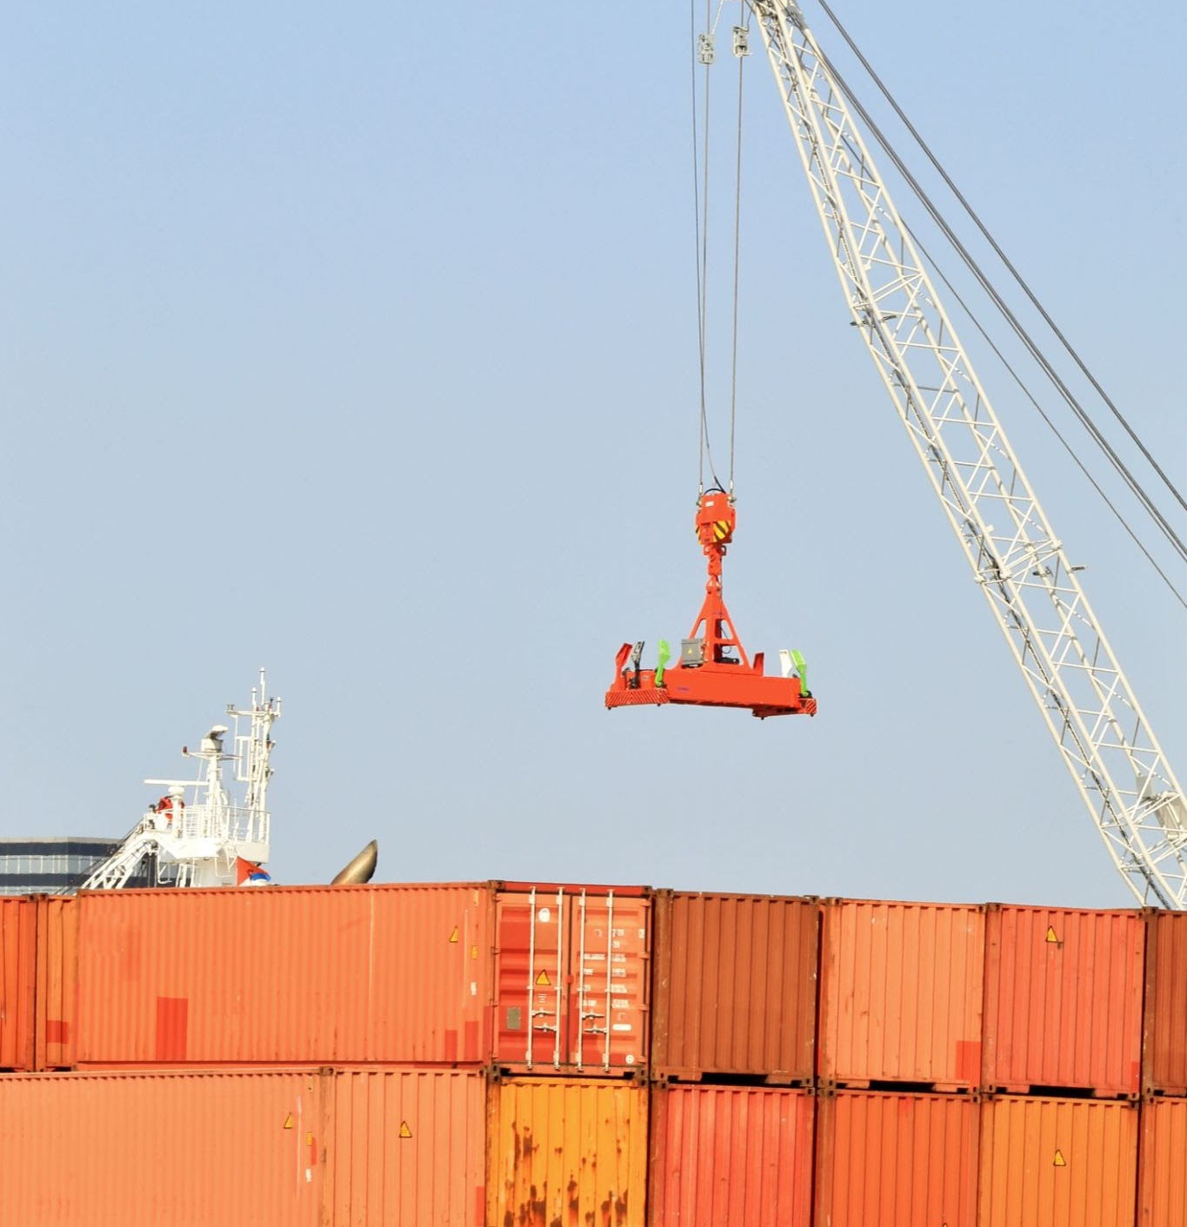
Why we’re here: To share some early tips and tricks for protocoling – and learn how organizations use protocols to create value, manage uncertainty, and advance their mission.
Summer of Protocols
Protocol Symposium
September 2025

Slide 5
What if you started paying attention to all of the containers around you?

Slide 6
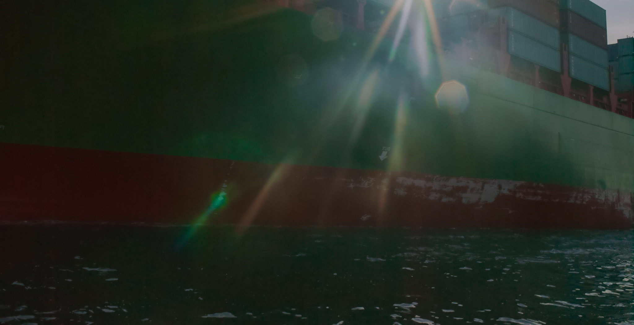


Protocol
A protocol is an ENGINEERED ARGUMENT
A protocol manages tensions through a mixture of rule and procedure.
A protocol enables repeatable behaviors at scale without a central authority.
10’s
100’s
!?
SoPers
Projects
Follow-on Impacts
Summer of Protocols
Protocol Symposium
September 2025

Slide 7

01
One measurement of success for research is a high ratio of conceptuality to practicality.
Keep in mind
Saying “protocol” =/= protocoling.
Protocoling is a long game.
🛑 rushing to make a difference.
Summer of Protocols
Protocol Symposium
September 2025

Slide 8
Literacy > Vocabulary
Literacy
Note: Terms must accumulate and foster more sophisticated thinking – if they don’t, it’s more like a word game that’s fun but lacks substance…
Vocabulary
Summer of Protocols
Protocol Symposium
September 2025

Slide 9
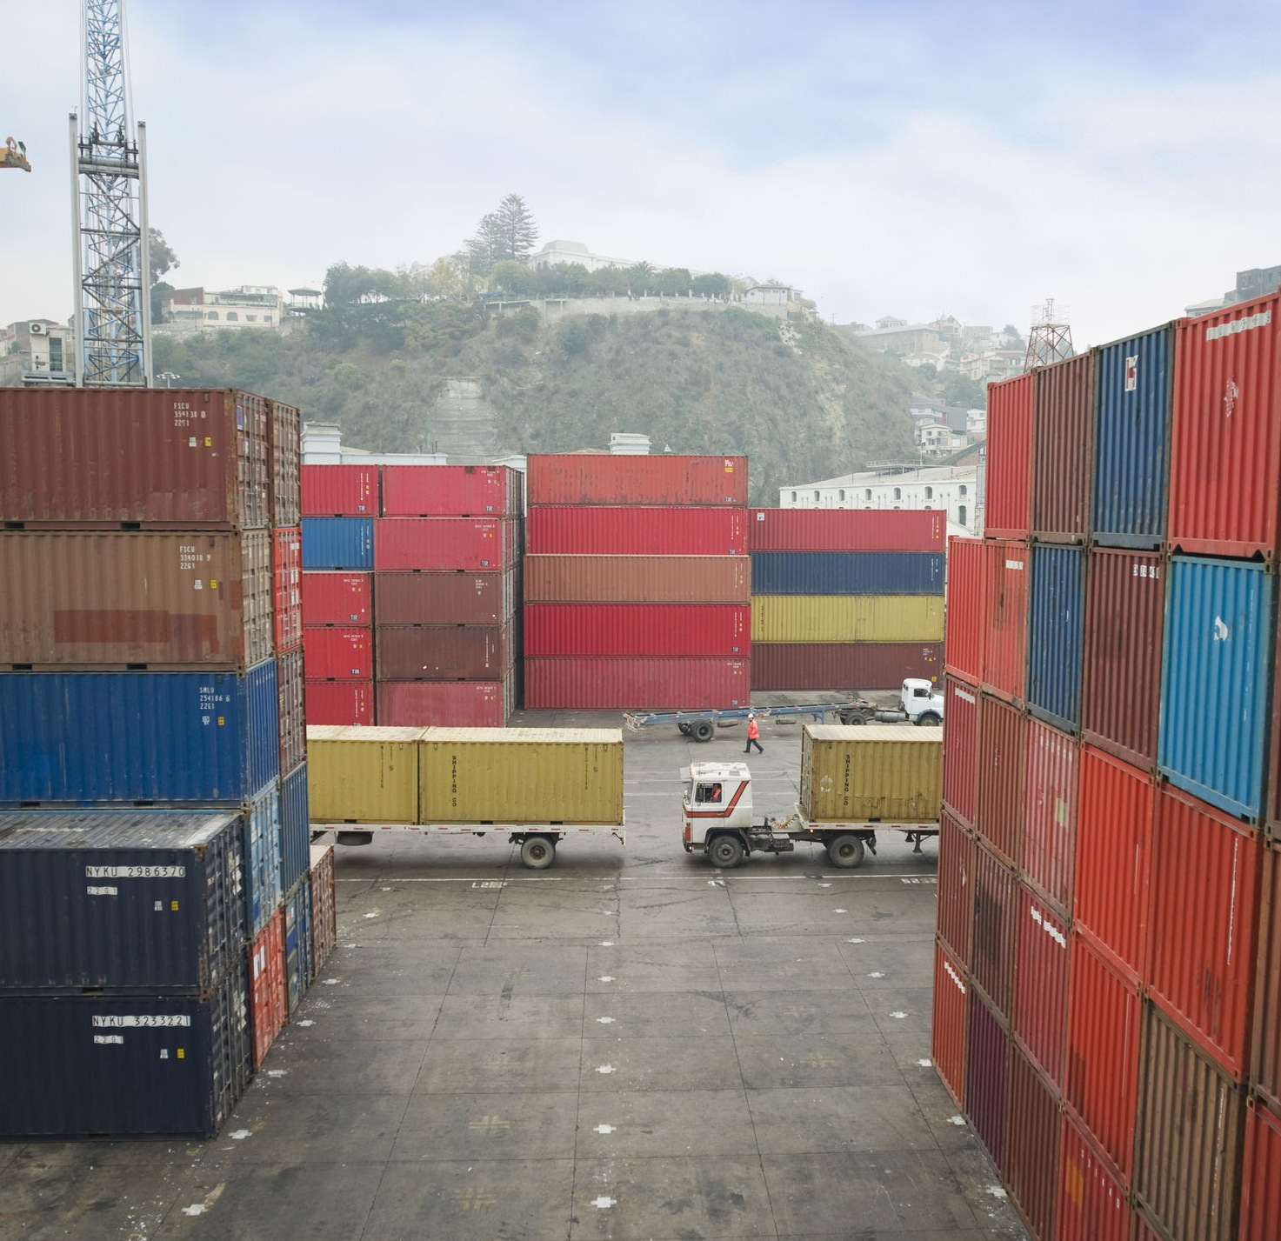
02
These aren’t testament but we (and others) have had good results so far.
Tips for Protocol Watching
Work with what you have.
Guide effort through the protocol.
Don’t expect radical change.
Ask: Chesterton’s Fence? Or Gordian Knot?
Identify actors.
Guess the packets.
Try to name the tensions.
Summer of Protocols
Protocol Symposium
September 2025

Slide 10
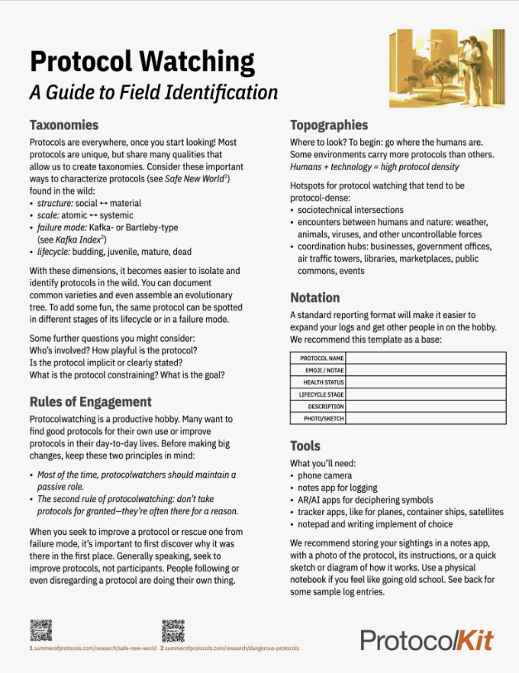
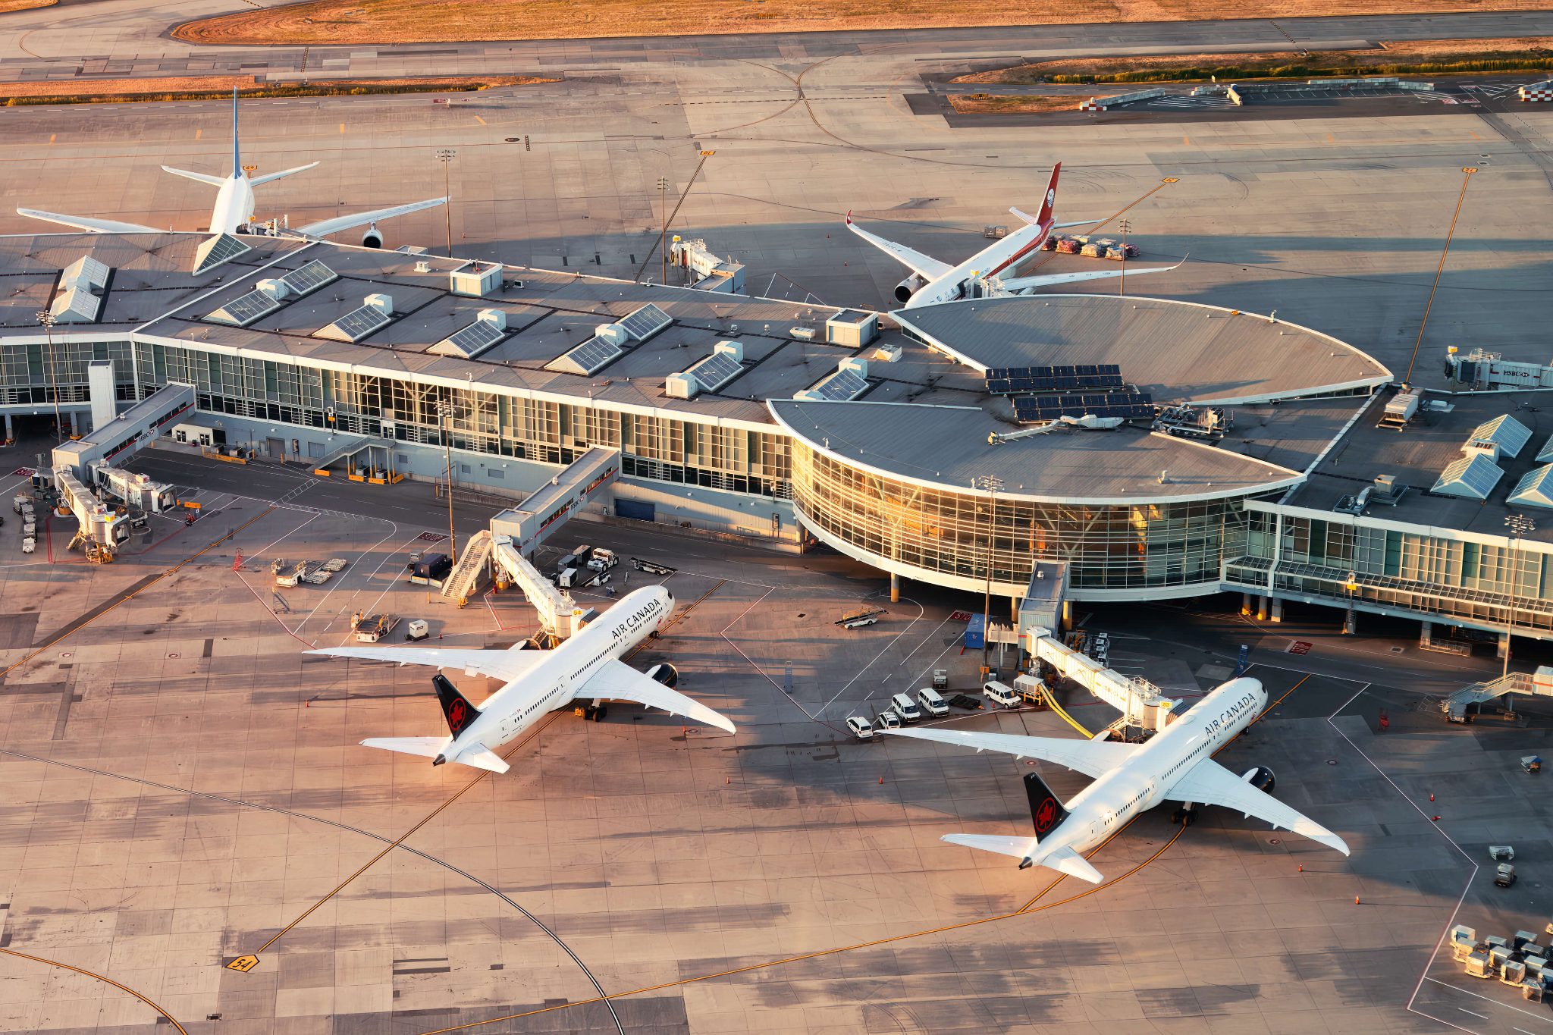
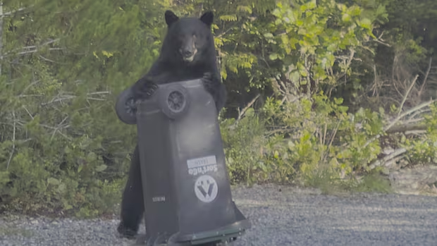
https://summerofprotocols.com/wp-content/uploads/2024/06/SCHROFF-Protocol-Watching-HANDOUT.pdf
Summer of Protocols
Protocol Symposium
September 2025

Slide 11

Summer of Protocols
Protocol Symposium
September 2025

Slide 12
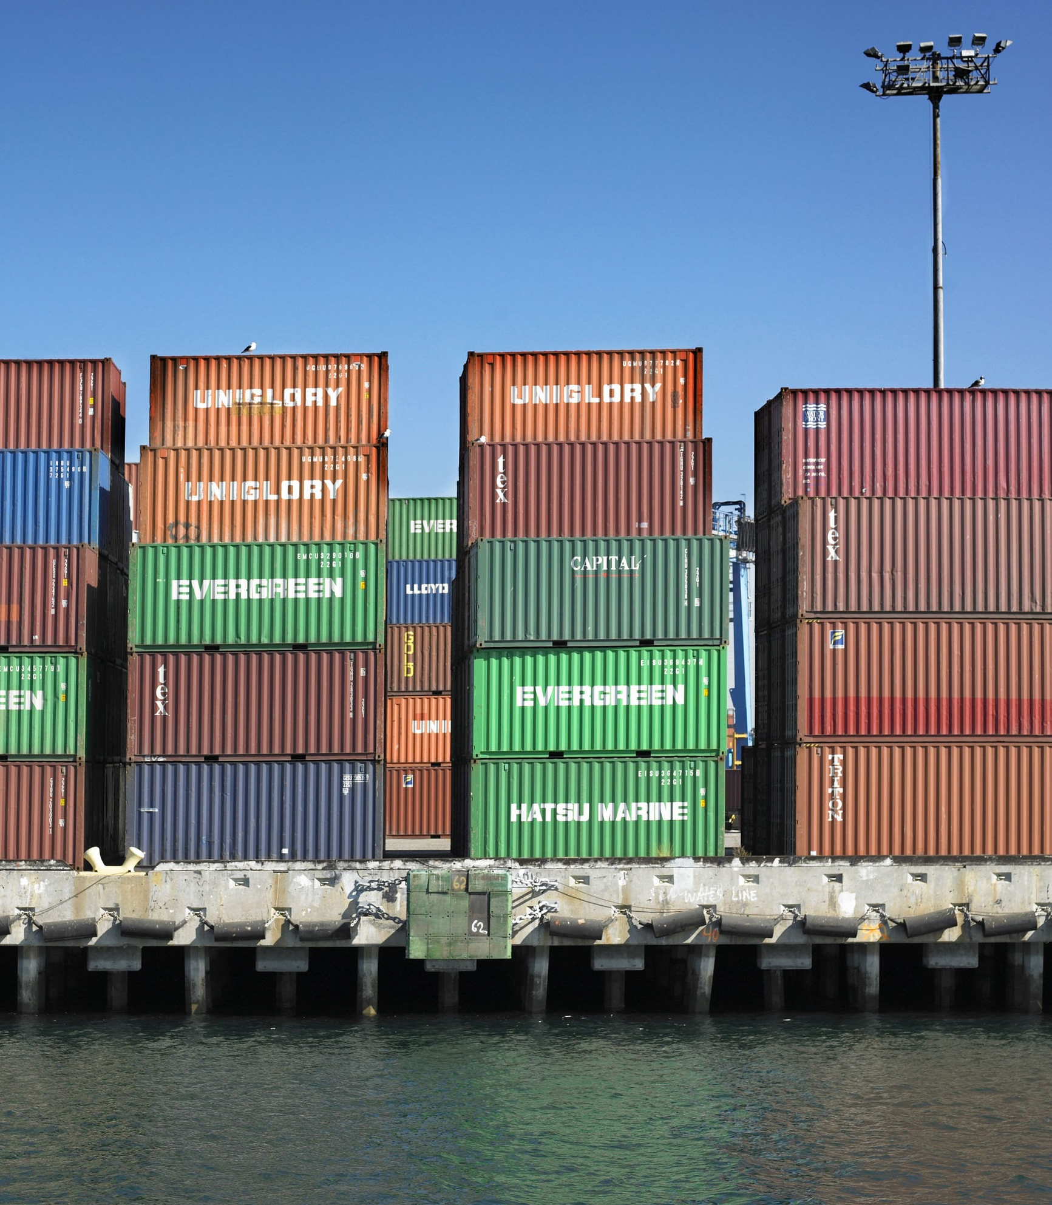
03
How to get after it.
5
Watch before you walk before you run
Entry points
Roadmap
Spend a lot of time umarelling!
Pick a couple small-p protocols and bring them back to life.
Study protocol research materials (not just SoP stuff).
Work on maintaining a larger, big-P protocol.
Design some small protocols in your own domain
Summer of Protocols
Protocol Symposium
September 2025

Slide 13
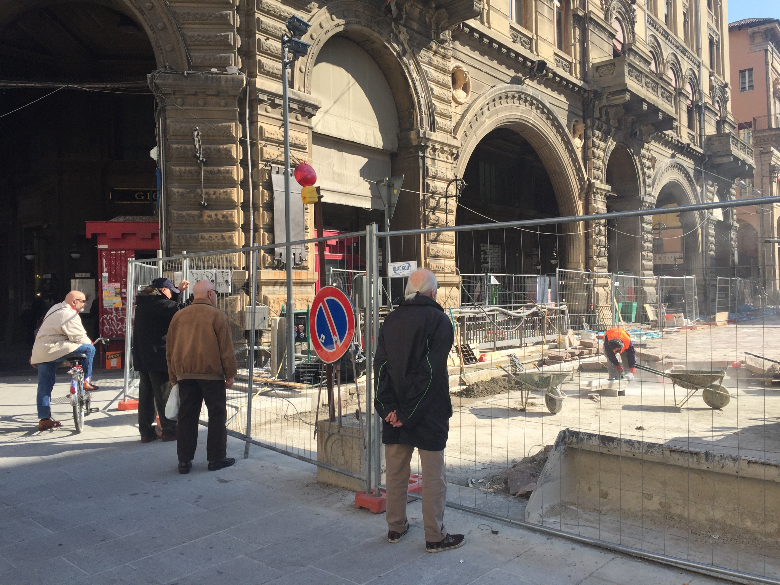
Summer of Protocols
Protocol Symposium
September 2025

Slide 14
Exercise (10min)
Summer of Protocols
Protocol Symposium
September 2025

Slide 15
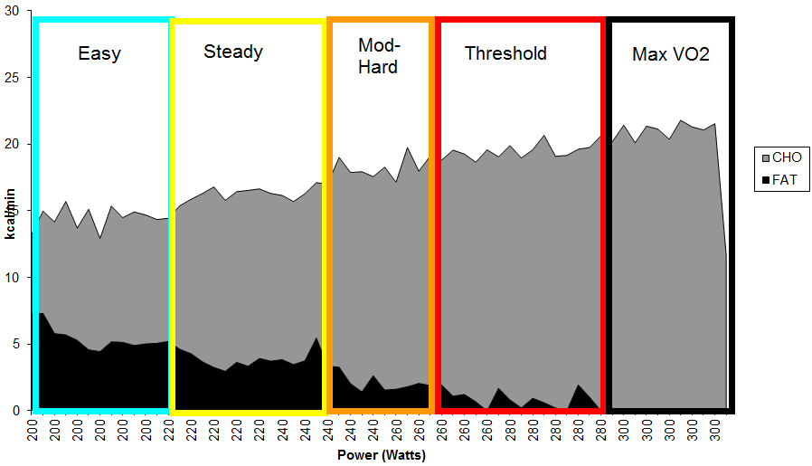
Good protocolists are good at
Fuel Partitioning!
Summer of Protocols
Protocol Symposium
September 2025

Slide 16
Protocol Patterns for Easy Pilots.
Starter Packs
Light
RETURNERS
Close loops on inventories and resource sharing.
DISCOVERERS
Uncover information through checks and questions.
DISOLVERS
Remove blockers by introducing extra slack rather than force.
AMPLIFIERS
Turn positive instances into signals that nodes that will repeat.
Medium
STAGERS
Define done; make checklists, versioning practices and MVPs.
QUARANTINERS
Constrain scope and scale to de-risk tests and new ventures.
INTERFACERS
Set expectations with clients, suppliers, collaborators. Micro-CRMs. Promote messaging and discipline, audit trails, organizational readability improvements.
Heavy
CODIFIERS
Make meta protocols that facilitate the transformation of repeated wins into playbooks, processes, guides and failures & near misses into dynamic non-events.
DEPRECATORS
Archive, dispose, store, or toss organizational waste.
ESCALATORS
Triage events with killswitches, ladders, coordinate leadership.
Summer of Protocols
Protocol Symposium
September 2025

Slide 17
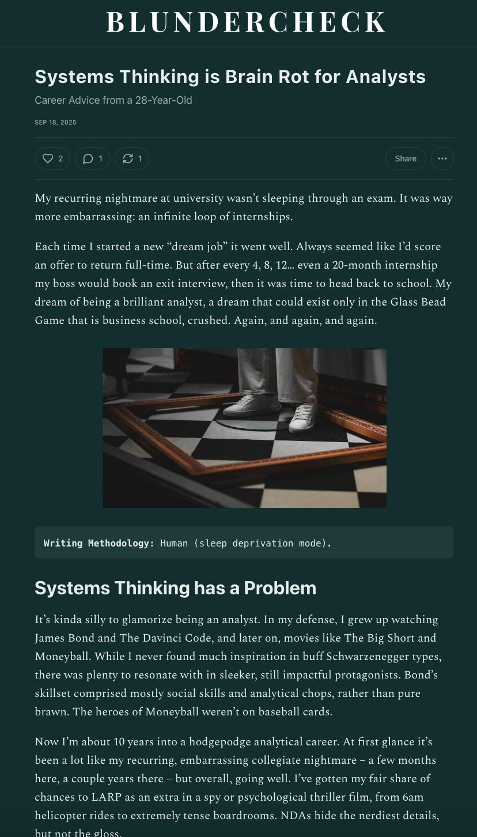
Why a new frame?
Summer of Protocols
Protocol Symposium
September 2025

Slide 18
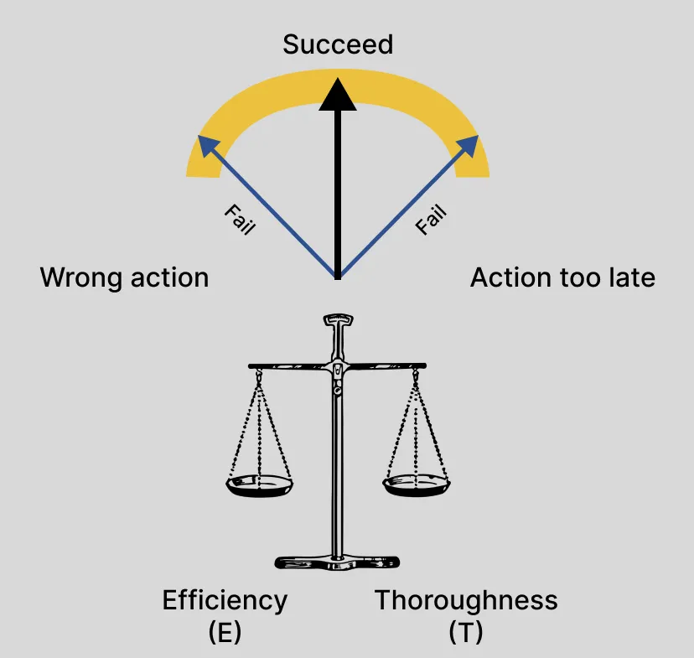
Summer of Protocols
Protocol Symposium
September 2025

Slide 19
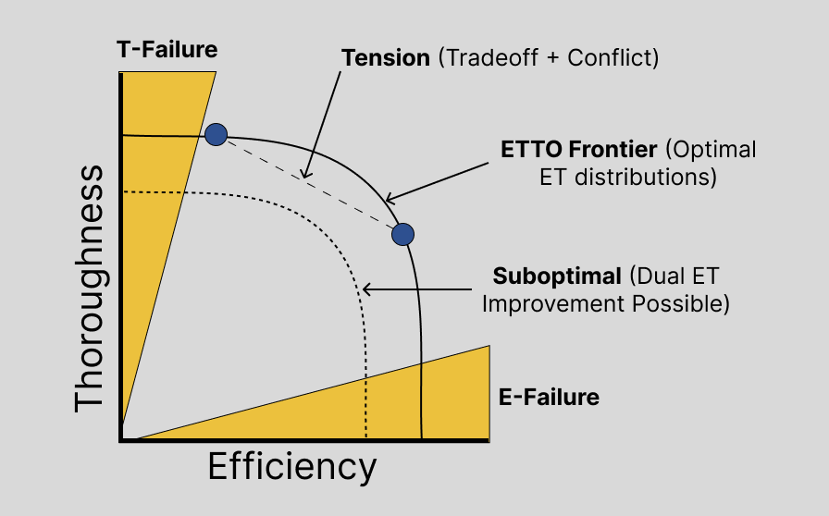
Summer of Protocols
Protocol Symposium
September 2025

Slide 20
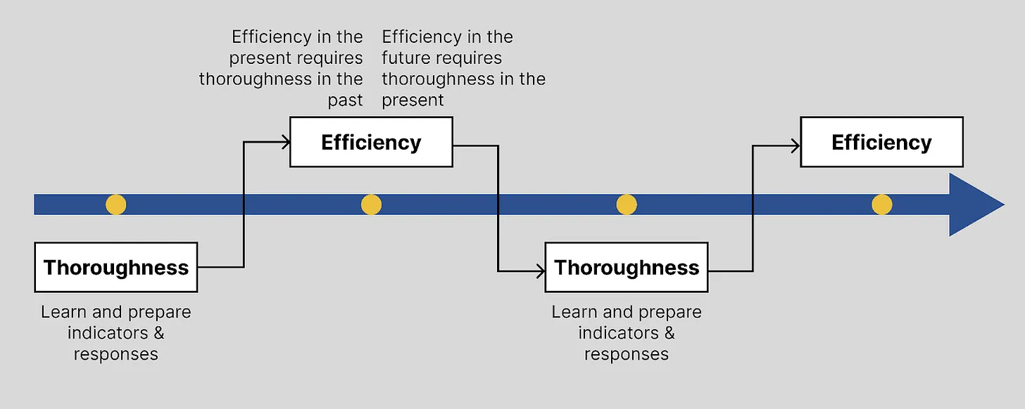
Summer of Protocols
Protocol Symposium
September 2025

Slide 21
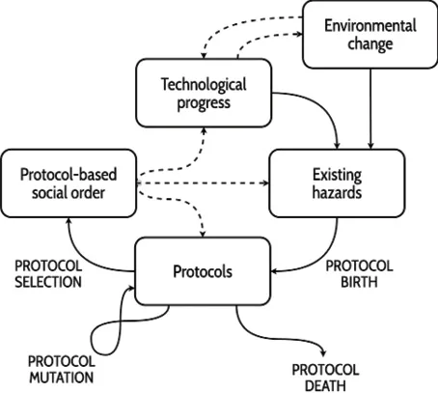
HOP - Hazard Oriented Protocolling
Summer of Protocols
Protocol Symposium
September 2025

Slide 22
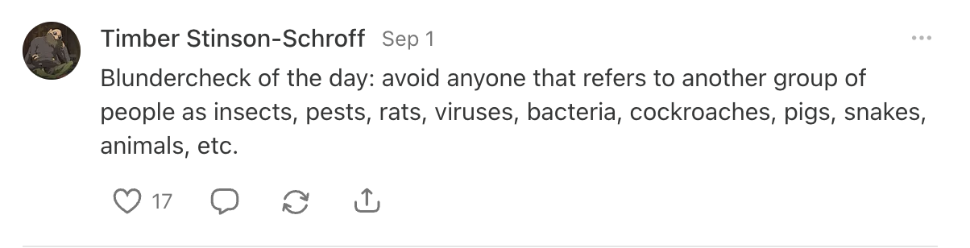
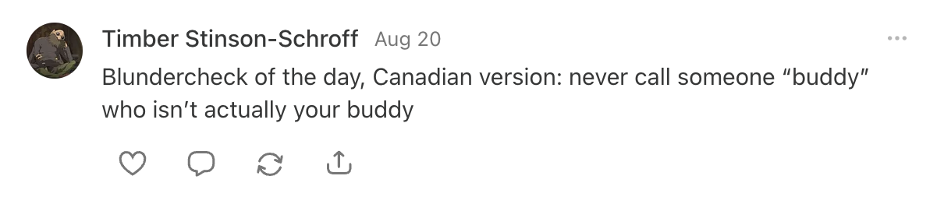
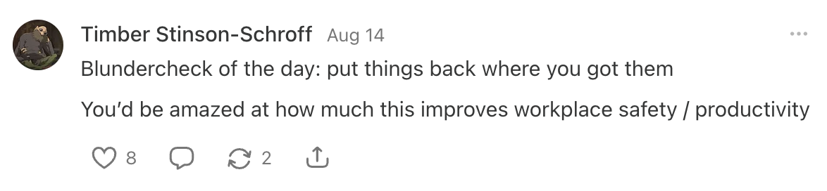
Daily Habits
Building Protocol Literacy
WYSIWYG
Summer of Protocols
Protocol Symposium
September 2025

Slide 23
Case Study
Thanks everyone for participating in the case study.
I also highly recommend the Special Interest Group on Protocols for Business. Calls are every two weeks on the SoP Discord.
🫡
A few highlights

Slide 24
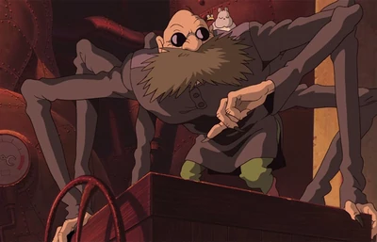
Spirit Animal (Not a Fish)
Approach
Summer of Protocols
Protocol Symposium
September 2025

Slide 25
What next?
Share what you build, study in Discord.
SIGFPT after this.
See you at the grad ceremony!
Want to connect? linktr.ee/timberss
Summer of Protocols
Protocol Symposium
September 2025

